Slide 1
Lecture 6 Algorithms for Linear Algebra
Prof. Brendan Kochunas
9/23/2019
NERS 590-004

Slide 2
Outline
Overview
Elementary Operations
Matrix Decompositions
Solving Linear Systems

Slide 3
Learning Objectives
Refresh our memory about basic operations that go into algorithms for linear algebra
Understand common matrix factorizations and how they can be used
Understand “10,000 foot view” of solving linear systems

Slide 4
Overview
What types of problems are solved with Linear Algebra?
Linear systems of equations
Eigenvalue problems
matrix factorization
Overdetermined system of equations
(Data fitting)

Slide 5
Linear System Fundamentals

Slide 6
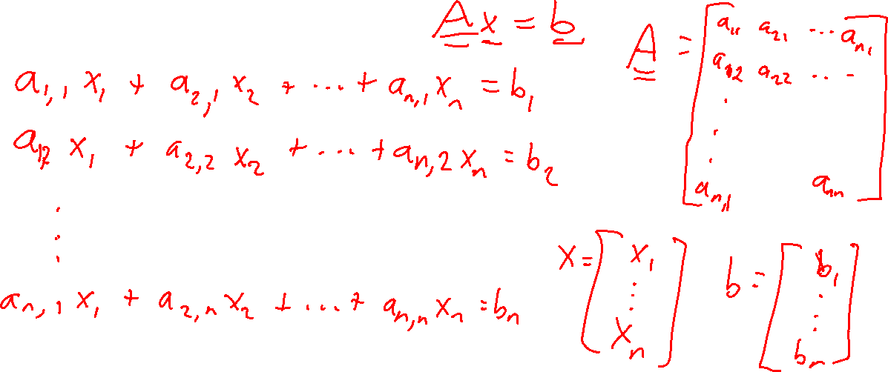
Basics of Linear Systems

Slide 7
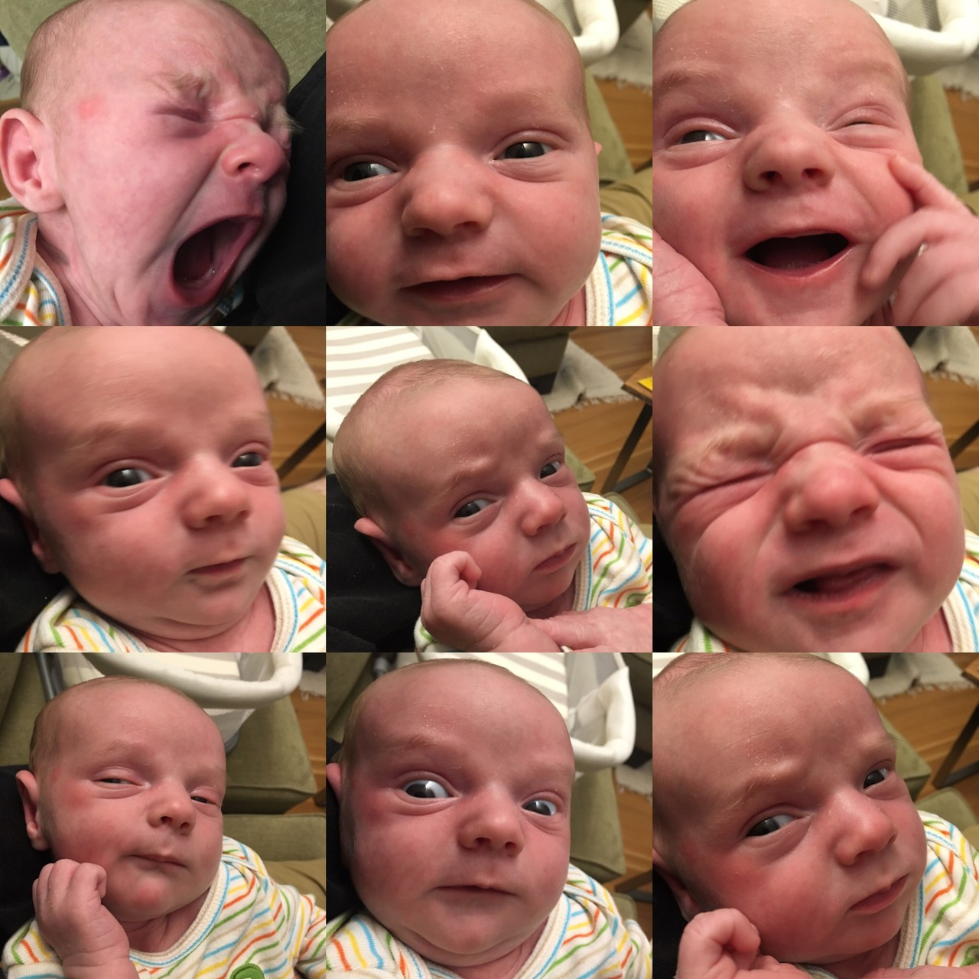
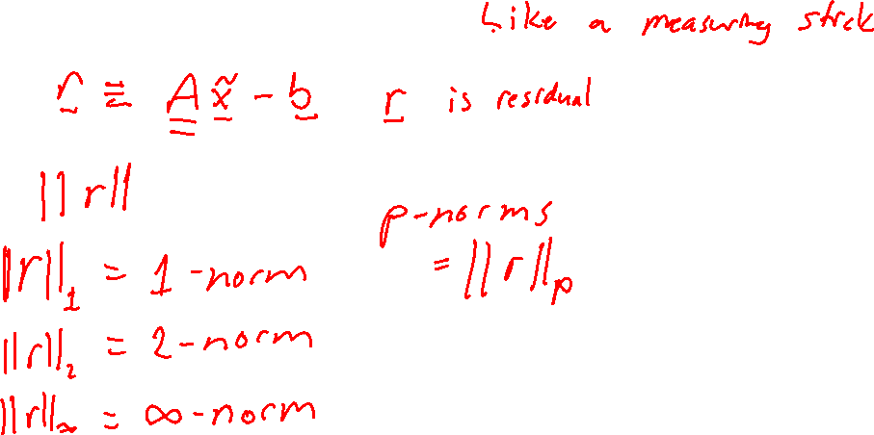
Norms of Vectors (1)

Slide 8
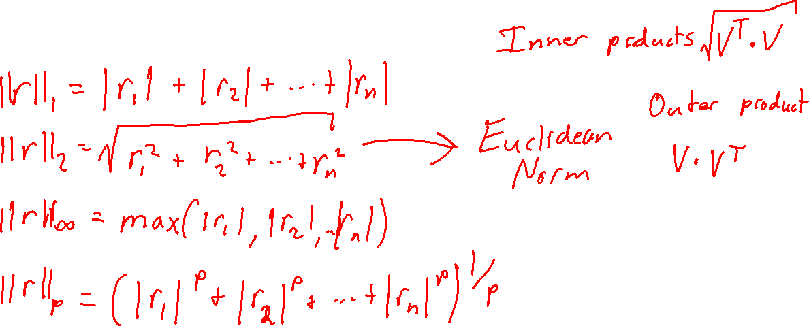
Norms of Vectors (2)

Slide 9
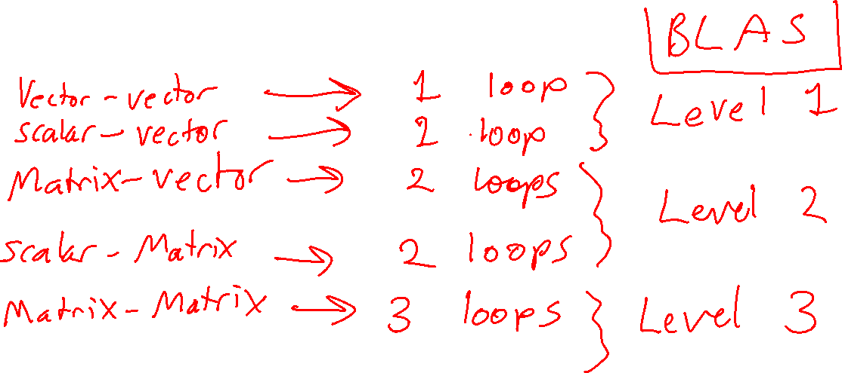
Types of operations in linear algebra

Slide 10
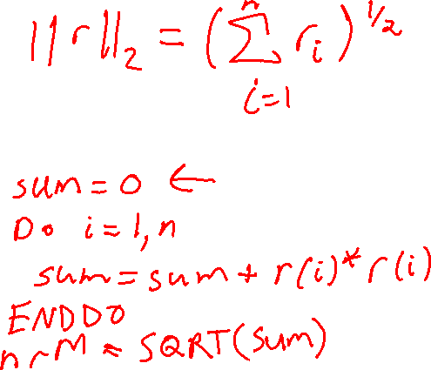
Going from Chalkboard to Terminal

Slide 11
Matrix Factorizations

Slide 12
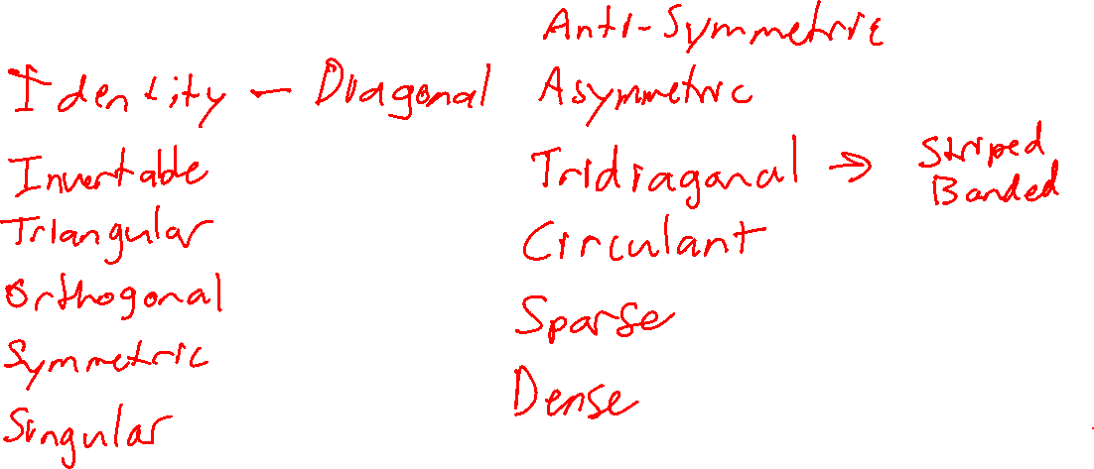
Types of Matrices

Slide 13
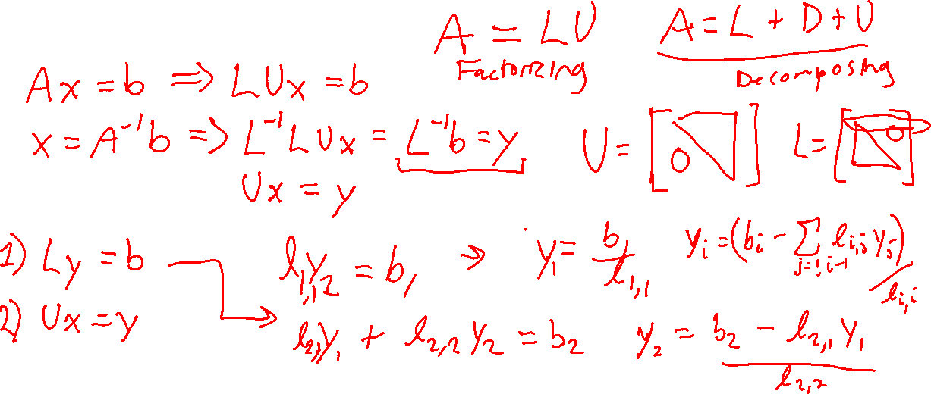
Factorizing Matrices (1)

Slide 14
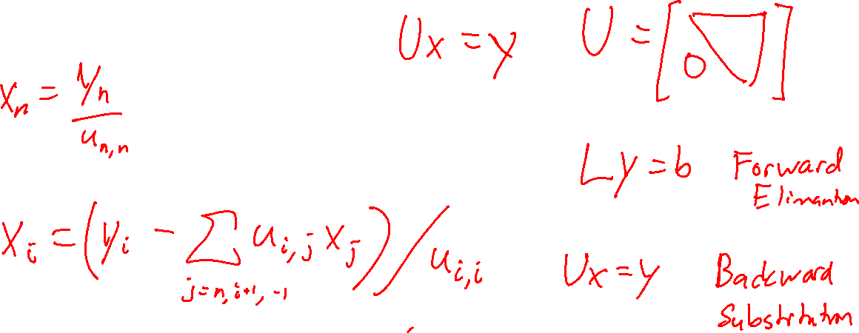
Factorizing Matrices (2)

Slide 15
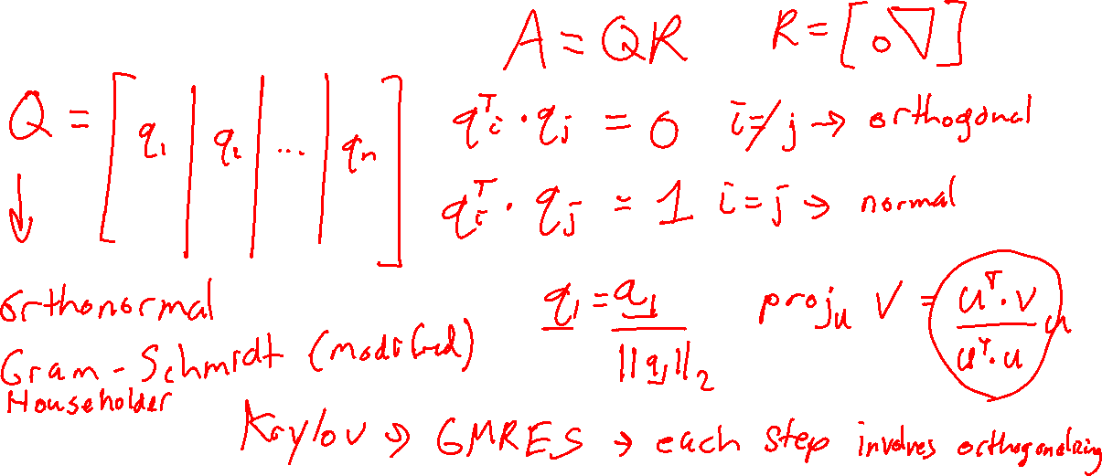
Factorizing Matrices (3)

Slide 16
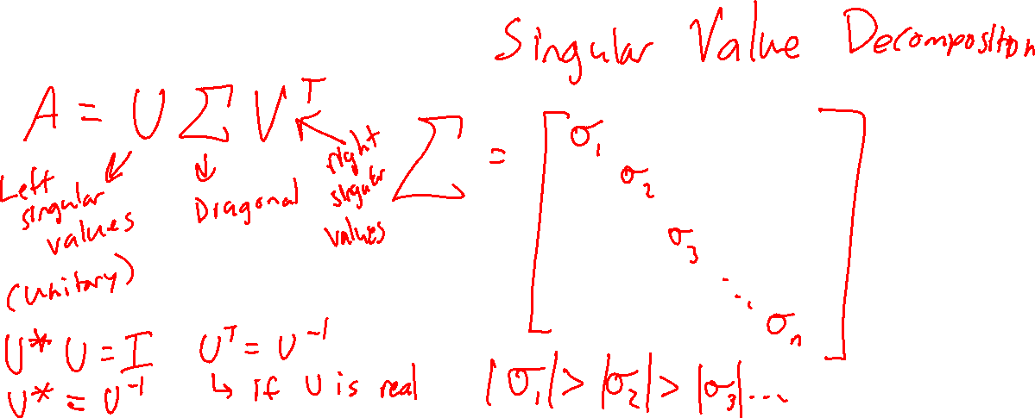
Factorizing Matrices (4)

Slide 17
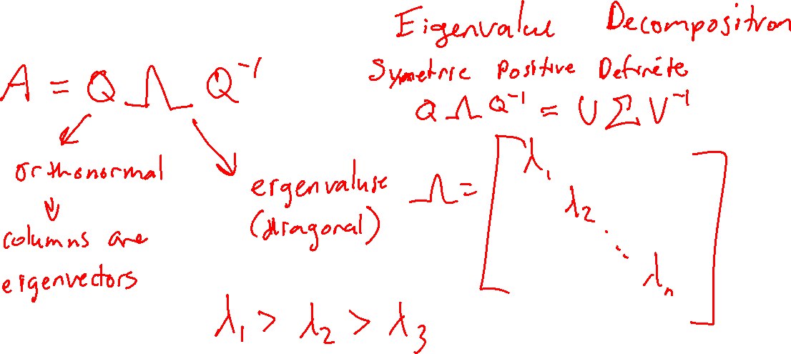
Factorizing Matrices (5)

Slide 18
Example of SVD Applied to Images
Original (512x512)
~k=262144
k=658 (too small, oversmoothed)
k=2813
k=7243 (undersmoothed)
Fig 5.1 from P.C. Hansen, et al., Deblurring Images: Matrices, Spectra, and Filtering, SIAM, 2006. https://doi.org/10.1137/1.9780898718874

Slide 19
Solving Linear Systems

Slide 20
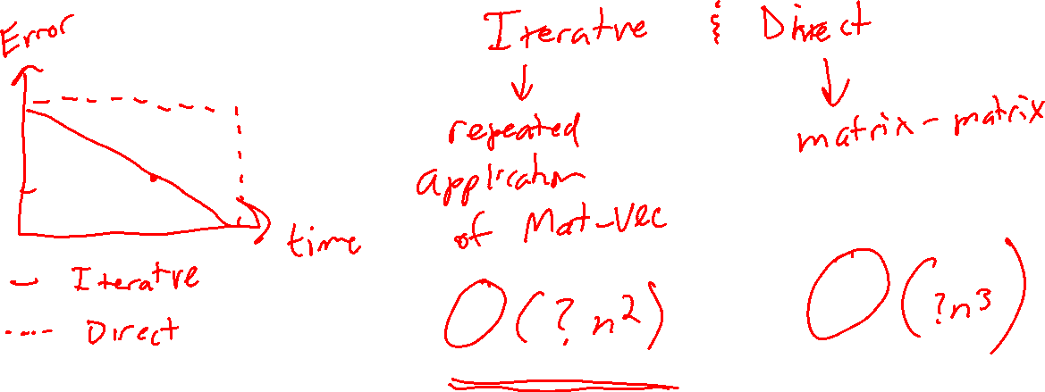
Solving Linear Systems

